Slide 1
Solar Energy
Capstone project

Slide 2
Sentiment and Demographic indicators
Why Solar
Twitter analysis
Demographic indicators for Solar installation propensity
Predictive Models
Conclusion
Future work

Slide 3
Introduction
Roughly 20,000 MW of solar capacity is forecasted to come online over the next two years, doubling the country's existing solar capacity. Growth is expected to be broad-based, with more than 16 states expected to top the 100 MW mark in 2016, up from 9 states in 2014.
The purpose of this report is to analyze several variables that may help predict what areas or consumers have a higher propensity to have solar installations in their homes, also find the best places zip codes to have solar panels installed, concentrating in New York.

Slide 4
Literature Review
There are currently no research papers on what areas, zip codes or customers have a higher propensity to enter into the solar industry by having solar installations on their roofs based on demographic data.
If residential solar adoption is like air conditioning, where 50 years later they had 80 percent saturation, solar on buildings could follow a similar path.
Solar cell efficiency is improving rapidly with technological progress and as solar costs decline, residential system sales increase exponentially. Therefore creating a model that can be used by solar companies to better understand and target customers should be in the top priority.

Slide 5
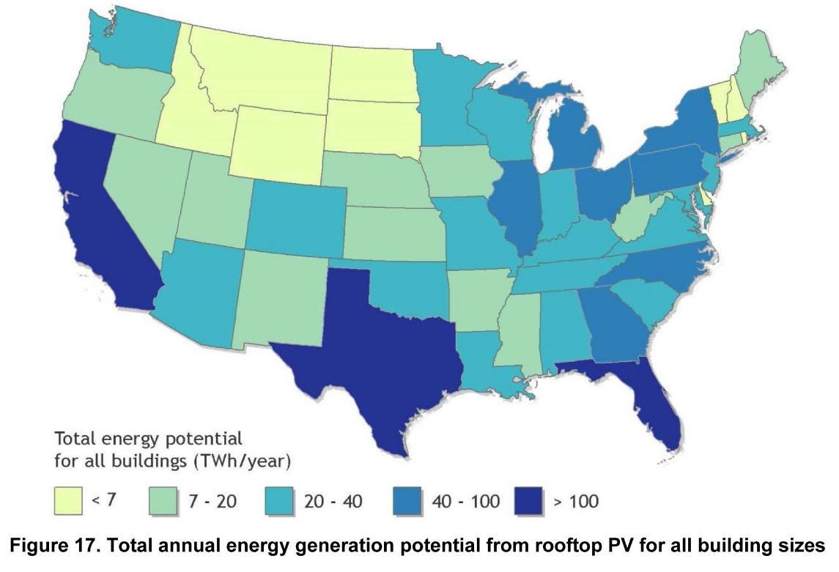
Literature Review
Some states with below-average solar resource (such as Minnesota, Maine, New York, and South Dakota) have similar or even greater potential to offset total sales than states with higher-quality resource (such as Arizona and Texas). This highlights the observation that solar resource is only one of several factors that determine the offset potential
Source: GTM Research

Slide 6
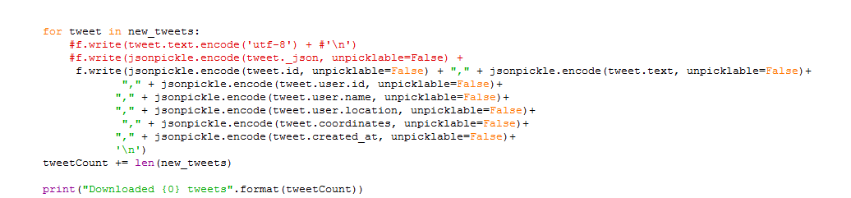
Dataset
Dataset 1: Tweets
Tweeter Data with 27000 individual tweets, data was collected randomly over a period of 60 days, with search words: GreenEnergy, SolarEnergy and SolarPanels.
This data set will be used to provide some insight into what people are saying and “feeling” about Solar Power.
Python Script used to download the dataset can be found here:https://github.com/jcasallas/Capstone/tree/master/Code
File: Twitter_SB Github
Modified code to download only fields needed
Original Code courtesy of: Rakesh Dhote

Slide 7
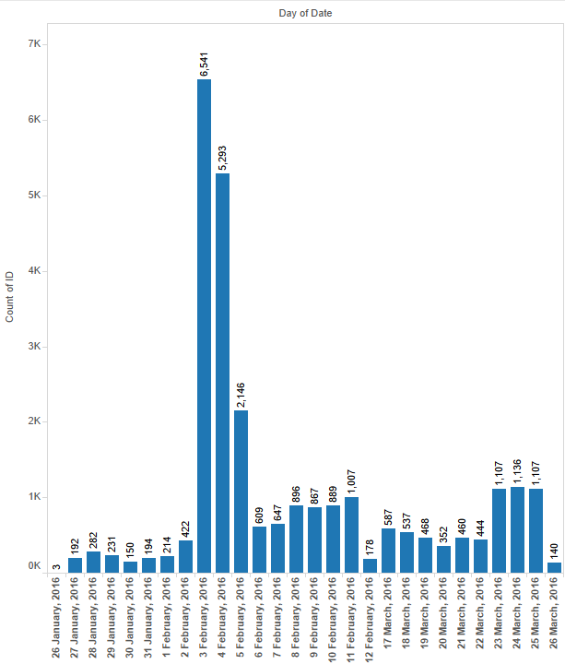
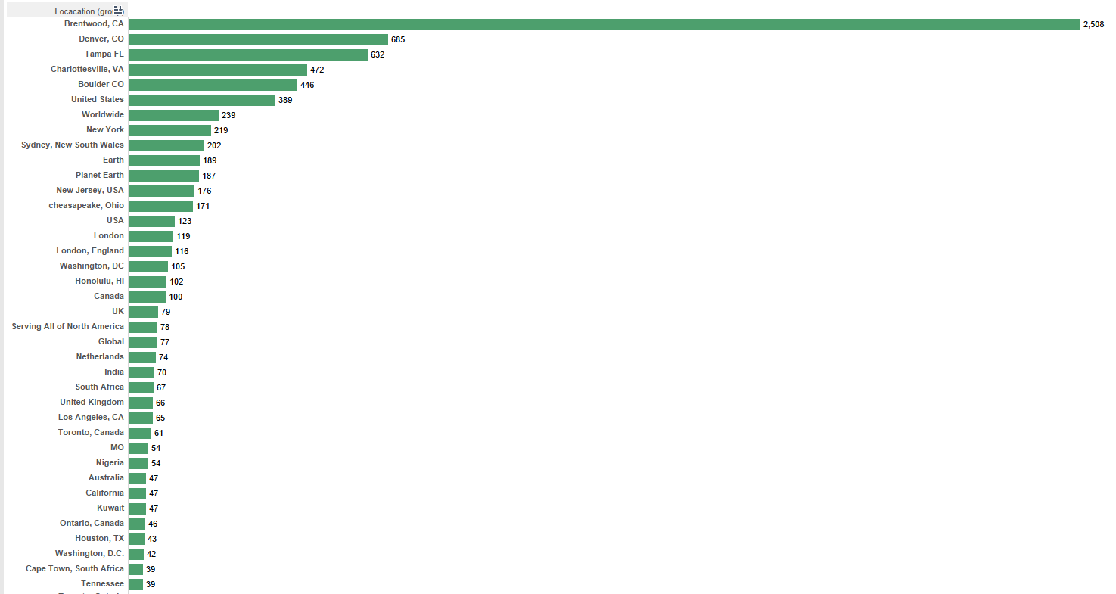
Twitter
Number of tweets recorded per day
Top Locations

Slide 8
Dataset
Dataset 2: Census Data and Demographics
There are several data sets used for the location and demographic analysis, below is a breakdown of the data sets:
New York Solar Installation Zip Level
About the data: Statewide 200kW or Less Residential/Non-Residential Solar Photovoltaic Incentive Program dataset includes the following data points for projects completed in the incentive Program beginning December 2000: Project number, location, sector, application received date, installation date, electric utility, purchase type, inverter manufacturer, inverter quantity, PV module manufacturer, PV quantity, project cost, incentives, kilowatt capacity, and expected annual kilowatt hour production.
Source: https://data.ny.gov/Energy-Environment/Statewide-200kW-or-Less-Residential-Non-Residentia/3x8r-34rs?

Slide 9
Dataset
Dataset 2: Census Data and Demographics
Income Data
Zip code file of two of the most commonly requested characteristics: median household income and mean household income:
Source: http://www.psc.isr.umich.edu/dis/census/Features/tract2zip/
Population
The 2010 US Census Population By Zip Code
Source: http://blog.splitwise.com/2013/09/18/the-2010-us-census-population-by-zip-code-totally-free/

Slide 10
Dataset
Dataset 2: Census Data and Demographics
Household Size
AVERAGE HOUSEHOLD SIZE OF OCCUPIED HOUSING UNITS BY TENURE - Universe: Occupied housing units
Source: http://factfinder.census.gov/faces/tableservices/jsf/pages/productview.xhtml?pid=ACS_14_5YR_B25010&prodType=table
Structure Type and Ownership
TENURE BY UNITS IN STRUCTURE - Universe: Occupied housing units
Source: http://factfinder.census.gov/faces/tableservices/jsf/pages/productview.xhtml?pid=ACS_14_5YR_B25032&prodType=table

Slide 11
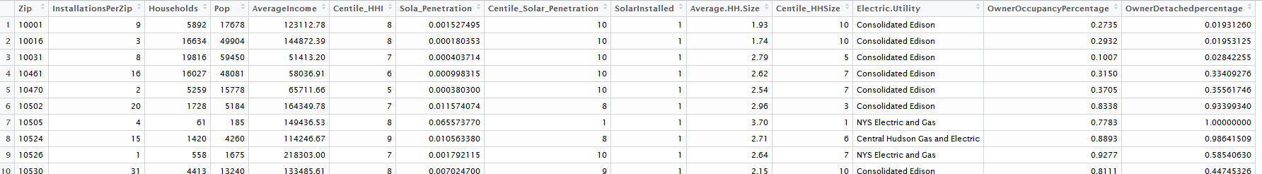
Dataset
Dataset 2: Census Data and Demographics
All the data sets above where modified to provide Zip level demographic information. Although there were margin of errors in the American Finder data sets, they were not included in the final results.

Slide 12
Approach
Part 1 – Acceptance research
10 Created World Cloud
9 Arrange words by frequencies
8 Removed Stop word and number and convert to lowercase
7 Added Clean text to a corpus
6
Sentiment Analysis completed
5
Tweet Analysis by words classification into positive and negative
4 Performed extra clean up on tweets by removing special characters
3
Downloaded a list of positive and negative words
2
Data Clean up - One main file to be uploaded
1
Data Research
Scrapped Twitter

Slide 13
Approach
Part 2 – Predictive Models Research
1
Data Research
Census and Open Data downloads
2
Data Clean up Clean several files in Excel to use only relevant Data
3 Data Upload to SQL Uploaded SVC files to a SQL Database for manipulation and analysis
5 Four Models run against the data: Logistc Regression, Multivariate, Random Forest, Bayes Classifier
6 Knowledge Discovery Build a decision tree using c5.0 for churn
7 Measure preformance using ROC Curve
8 Model chosen ad saved to be applied to future records
4 Statistical Analysis of Data and Relationships

Slide 14
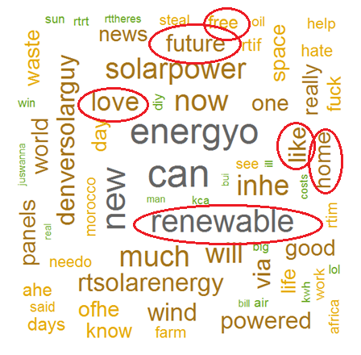
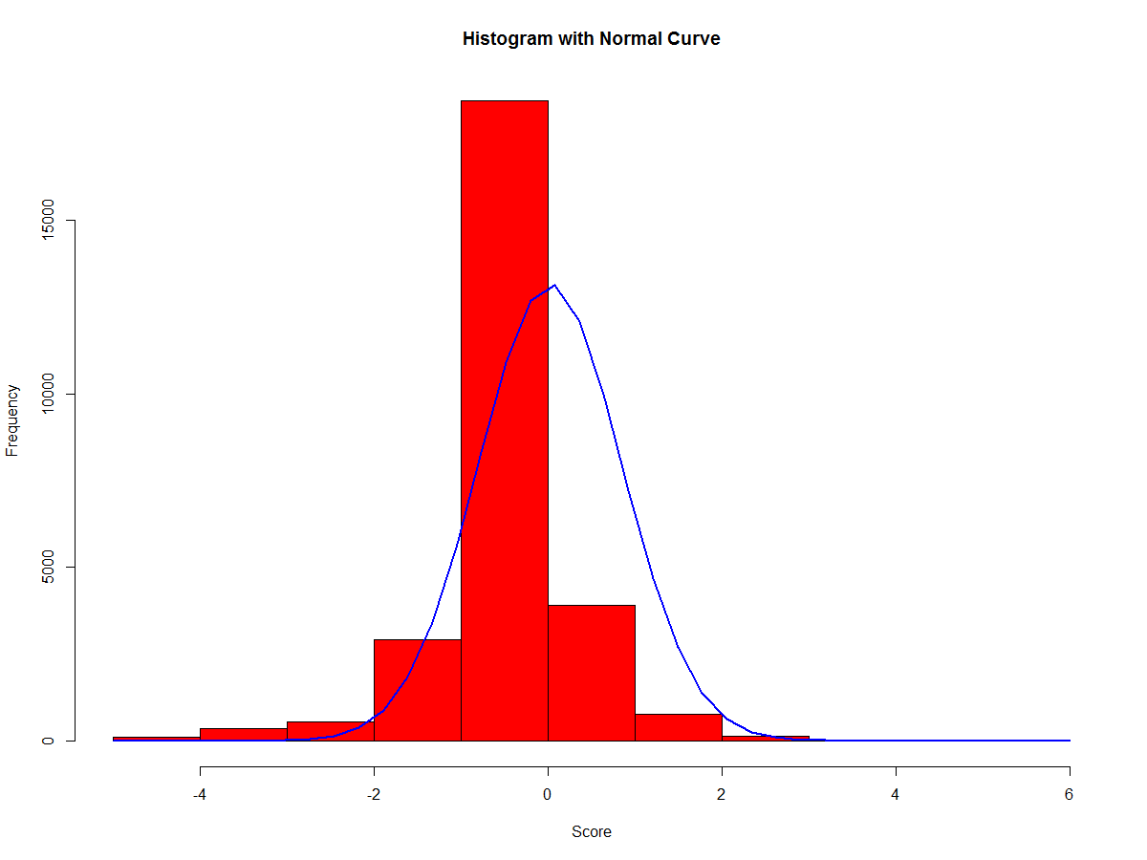
Results
First we look at the first part of the analysis, Solar acceptance.
Below is a word cloud of tweet gather over a period of time containing search results for solar keywords
As we can see here there are several positive words, associated with the search which lead us to believe there is a positive “feeling” associated with solar energy.
Now we analyze the positive and negative words

Slide 15
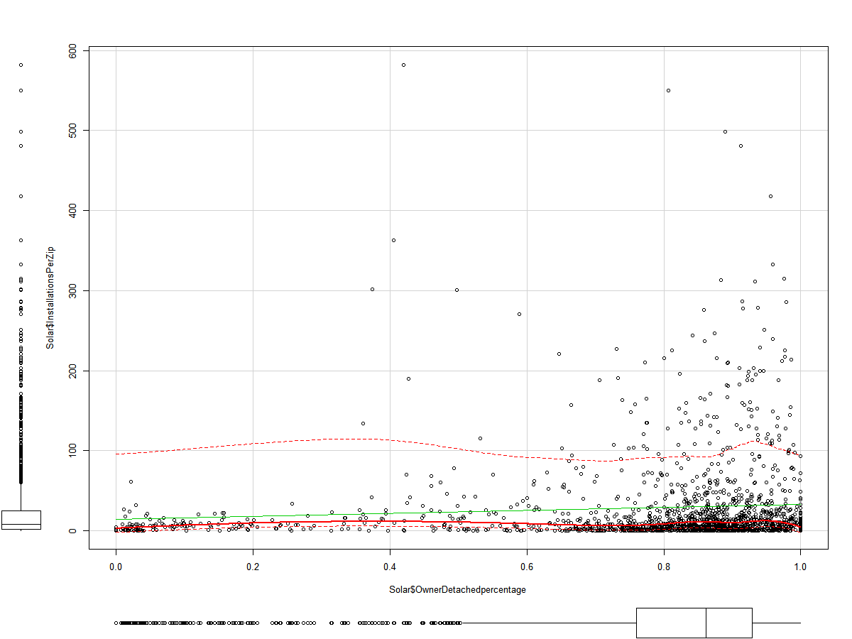
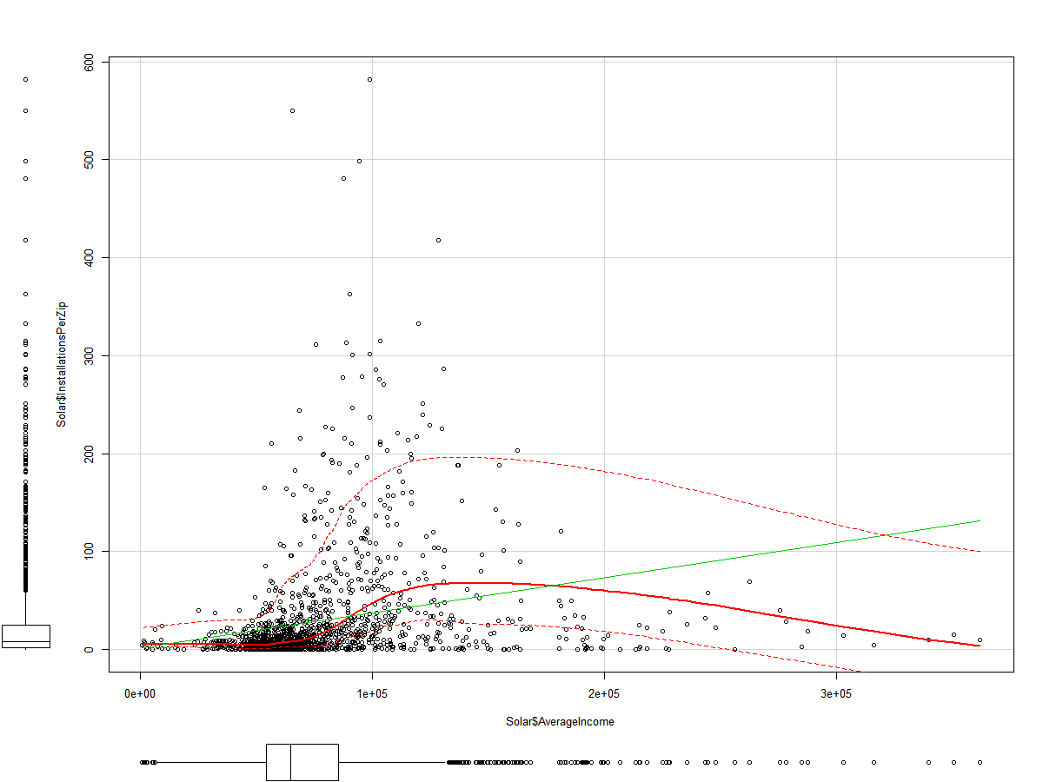
Results
Analysis the data sets and relationships
Figure 1: shows a higher number of installations are present when the percentage of detached homes is higher, this makes sense since majority of residential installation are for detached homes.
Figure 2: shows the relation between installations and Income, here we can see there are a high number of installations for customer with incomes around the $100,000, this shows that solar installations although have come down in price in recent years, customers still need a significant income, it also shows how customers with an income of $100,000 are more likely to purchase solar panels.
Figure 1
Figure 2

Slide 16
Results
Predictive Models
Based on this we would assume the acceptance and sentiment for Solar Power is positive, next we look at how to predict if someone is more likely to purchase solar installations.
During the analysis we looked at four main models:
Logistic
Multivariate
Random Forest
Naïve Bayes.
Using 5 variables to predict Solar Installed
Households
AverageIncome
Average.HH.Size
OwnerOccupancyPercentage
OwnerDetachedpercentage

Slide 17
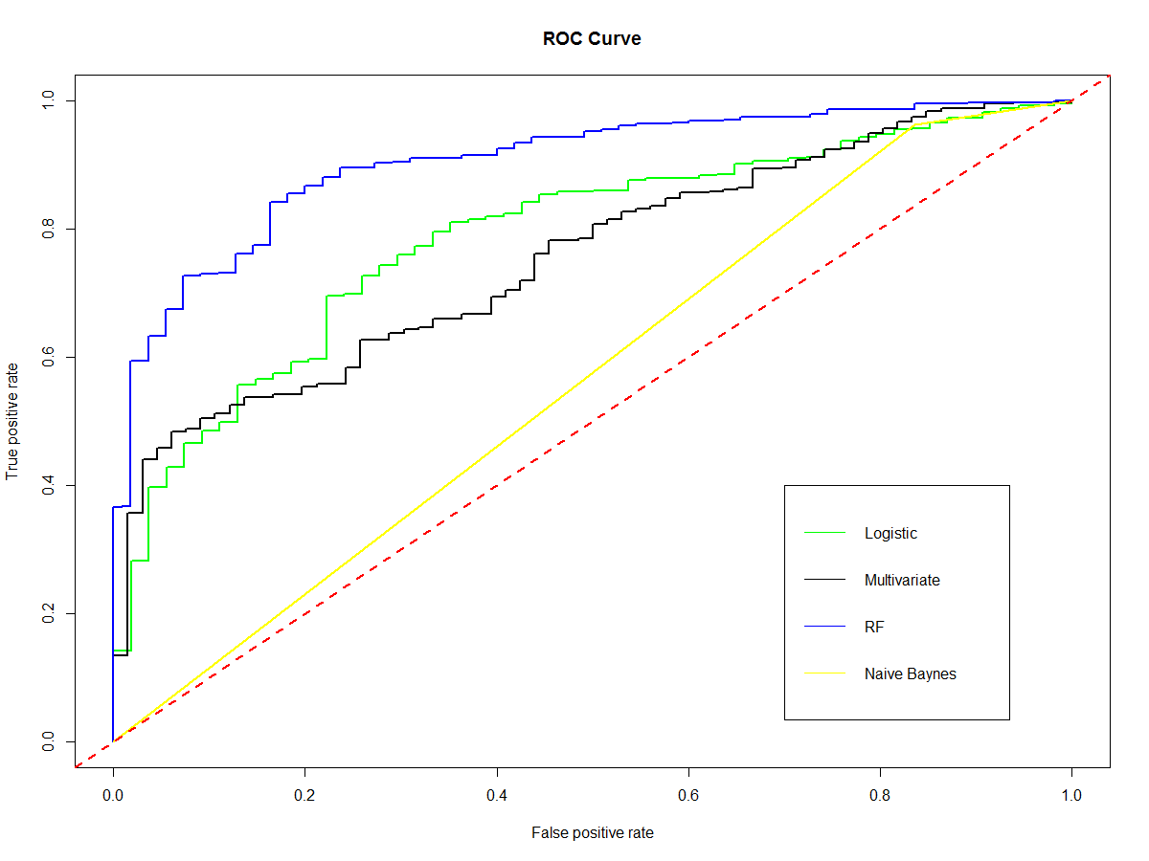
Results
Plotting the results
Threre is a great benefit of using an ROC curve to evaluate a classifier instead of a simpler metric such as misclassification rate, in that an ROC curve visualizes all possible classification thresholds, whereas misclassification rate only represents error rate for a single threshold.
Logistic: 0.7873707
Multivariate: 0.7530163
Random Forest: 0.9043915
Naïve Bayes: 0.5636606

Slide 18
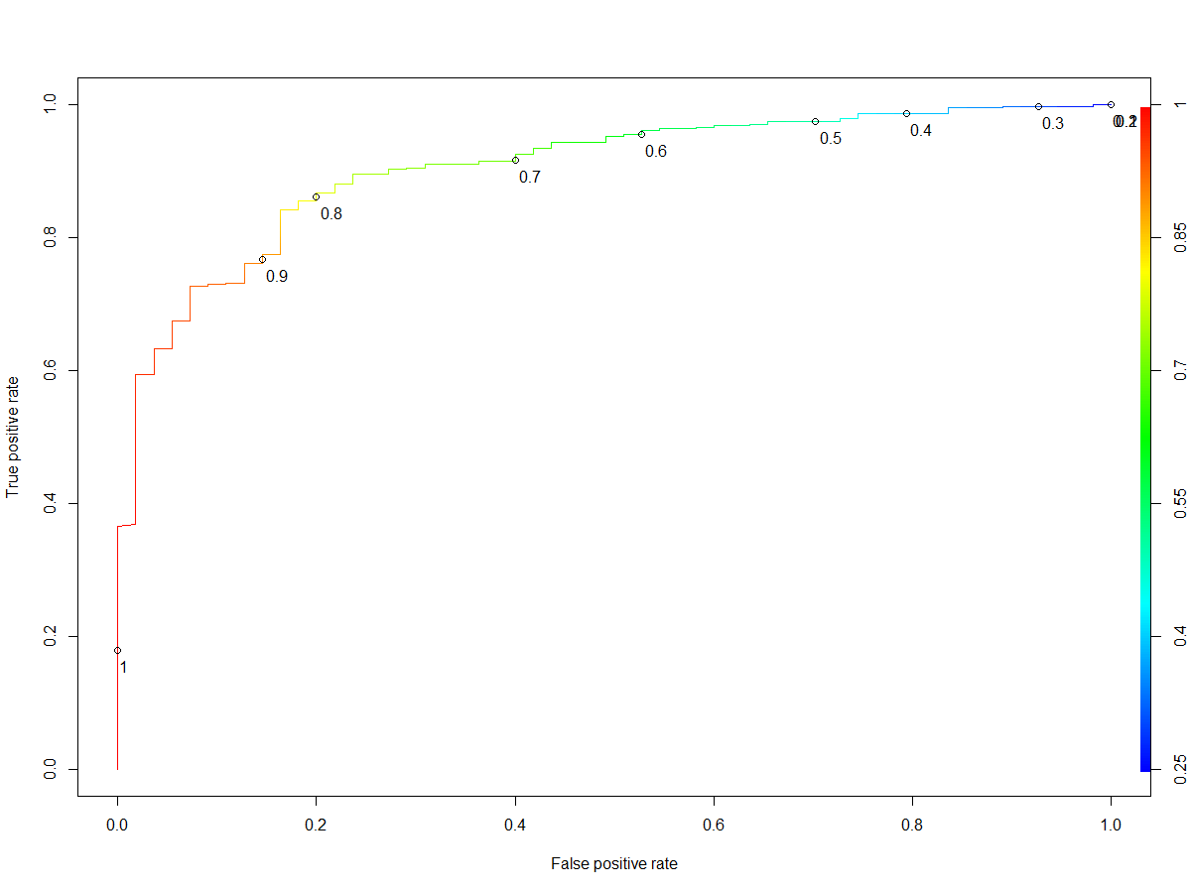
Results
Random Forest
Random Forest performed better than the Logistic, Multivariate and Naïve Bayes models. This means the Random forest classifier has done a better job at separating the classes. We would use Random Forest to predict whether or not a person is more or less likely based on the variables
Based on the performance of each model, it was determined that the Random Forest Model was the best performing model with a 90.4% accuracy and did very good job at separating the classes.

Slide 19
Conclusions
In this report, I have considered several demographic variables for predicting and selecting suitable areas with a higher probability within New York for potential residents to have solar installations on their residential rooftops. I did analysis on the available and usable demographic data from several census and open data sources
Using Statistical models I made zip level estimates/predictions of the probability of solar installations, and generated some simple rules that can be implemented to target specific set of prospects

Slide 20
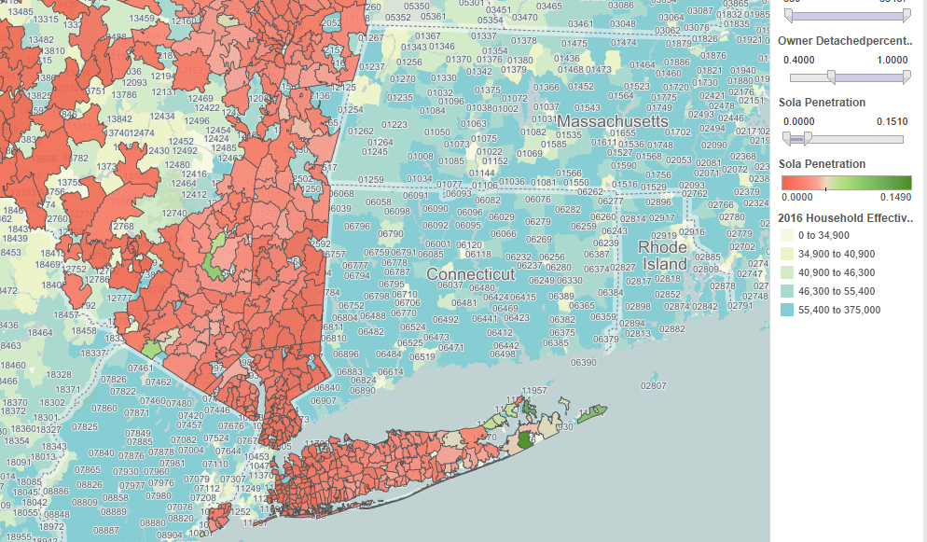
Conclusions
During the analysis I was able to determine that areas where there is a higher penetration of detached homes, where there is a higher number of households and higher income are more likely to have installations
The green areas in the map below show the targeted Zips for solar installations

Slide 21
Future Work
There are many possible directions for future analyses, and it is my hope that the data there will be more data available from municipalities, utility providers, and solar energy researchers.
There is also a potential to incorporate Lidar data to estimate rooftop area suitable for Solar development/installations. The Lidar data correlates to the elevation of the first object detected and creates a digital surface model for each city.

Slide 22
THANK YOU

